Slide 1


Slide 2


C# From 6 to10
Kathleen Dollard
Kendra Havens
And Friends

Slide 3
Abstract
C# changes in recent years allow you to write more concise and resilient code. Alongside that new features in Visual Studio encourage consistency and spot code problems. That's all great, but my goodness there's been a lot! And most of the coverage has been feature by feature, year by year, version by version. Spend a few hours with Kathleen and friends as they focus on how these features work together and how you can leverage that to write great code! The story will start with C# 6.0 features, with a focus on underutilized and misunderstood features, with extra time for C# 8 and upcoming C# 9 features.

Slide 4
The Team!
Kathleen Dollard: PM on the .NET Team working on languages, etc.
Kendra Havens: PM on the .NET Team working on VS productivity, etc.
Fred Silberberg: Engineer on Roslyn Compiler team
Andrew Hall: Engineer on VS Productivity team
Chris Sienkiewicz: Engineer on Roslyn Compiler team
Jared Parsons: Engineering lead on Roslyn Compiler team
Special Guest!

Slide 5
The Team!
Kathleen Dollard: PM on the .NET Team working on languages, etc.
Kendra Havens: PM on the .NET Team working on VS productivity, etc.
Fred Silberberg: Engineer on Roslyn Compiler team
Andrew Hall: Engineer on VS Productivity team
Chris Sienkiewicz: Engineer on Roslyn Compiler team
Jared Parsons: Engineering lead on Roslyn Compiler team
Mads Torgersen: Lead Language Designer C#

Slide 6
Repos
https://github.com/KathleenDollard/sample-csharp-6-9
https://github.com/kendrahavens/DevIntersection2020.git
You may use your own machine or the VMs
The productivity experience will be Visual Studio 2019 16.8 (Nov 2020)
Almost all of what we show works in the Community (free) edition

Slide 7
Agenda
Chapter 1
Themes for today (and version reference)
Simplifying code
Chapter 2
Productivity/simplifying coding experience
Chapter 3
Correctness
Nullability
Pattern matching
Chapter 4
New ways to think about code
Review
Guest appearance
Themes
Simplifying code
Productivity
Correctness
Nullability
Pattern matching

Slide 8
C# 6
Auto properties
Expression bodies
using static
Null Conditional
String interpolation
Exception filters
nameof
await in catch/finally
Associative initializers

Slide 9
C# 7.0
Out variables
Tuples and deconstruction
Pattern matching
Discards
throw expressions
More expression body members
Binary literals
Digit separators
ref locals and returns
Generalized async return types
Local functions

Slide 10
And the minor releases…
C# 7.1
C# 7.2
async Main method
default literal expression
Inferred tuple element names
Pattern matching on generics
“Safe” code enhancements
Example: ref readonly
Non-trailing named arguments
Leading numeric underscores
private protected (internal/protected)

Slide 11
And the minor releases…
C# 7.3
More “safe” code enhancements
Tuples support == and !=
Enum, Delegate & unmanaged constraints
Attributes on auto-property’s fields
Better overloads
Out variables in still more places

Slide 12
C# 8.0
readonly members on structs
More pattern matching!
using declarations
Better (static) local functions
Async streams
Async disposable
Indices and ranges
Default interface members
More “safe” code enhancements
Nullable reference types
Null coalescing assignment
$@“ and @$“ both work

Slide 13
C# 9.0
Init only properties
Records
With expressions
Value based equality
Top level programs
Logical patterns
Extension GetEnumerator
Extending partial
Improved target-typing
new and ??, ?: support
Covariant returns
Parameter null checks !!
Lambdas: static and discards
Native ints, function pointers
Better “safe” code, local functions, patterns
Module initializers
Notes:
17:45 in Mads/Dustin Build demo for pattern matching
44:00 Records

Slide 14

The App
Extends a sample Bill Wagner began
Toll bridge charging is a bit complicated…
(actually, we have no idea how it works; the signs tell us what it costs)
Tutorial: Build algorithms with pattern matching | Microsoft Docs
https://docs.microsoft.com/en-us/dotnet/csharp/tutorials/pattern-matching

Slide 15
Theme: Code simplification
Auto-implemented props: BillingSystem.Account
Expression bodies: BillingSystem.Account.State
Index and Range: BillingSystem.Account.State
Target type new: BillingSystem.AccountList._random
Object, collection, dictionary initializers: BillingSystem.AccountList.FetchAccounts
Out variable declarations: BillingSystem.AccountList.LookupAccountAsync
Conditional and throw expressions: BillingSystem.AccountList.LookupAccountAsync
Return to FetchAccounts4

Slide 16
Theme: Code simplification
Local functions (and static): BillingSystem.AccountList.GenerateTestLicense
String interpolation: TollCollectorLib.TollSystem.ChargeTollAsync
using declaration: Common.WriterWrapper.WriteLinesToFile
Binary literals and digit separators: Common.LogLevel
Clean up all messages

Slide 17
Not currently covered - simplify
using static
Default literal

Slide 18
Break

Slide 19


Slide 20
Theme: Productivity (simplify your experience)
Codefixes and refactorings
General tooling tips!
.NET 5 analyzers
Analysis levels
Editorconfig
Notes:
Second half of second hour
(coordinate with Andrew)
Limit content to C#8/9 level of detail
Parameter name hints
Extract Base
Inline method
DateTime and Regex completion
IntelliCode (maybe)
EditorConfig (apply file header), SDK Analyzers, dotnet-format
New git window
Code search Ctrl+Q

Slide 21
Analyzers
Installable from NuGet, included in .NET 5 (some)
Catch common mistakes or errors in IDE, command line, or CI builds
Some provide fixes through IDE
Configurable through editorconfig
Public API for providing own analyzers/codefixes

Slide 22
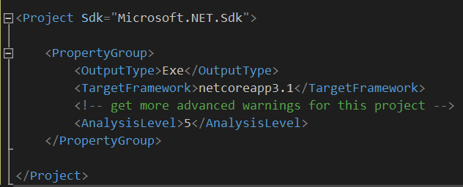
Analysis Levels
Use when you need them
You can use .NET 5 analyzers even with projects that target an earlier framework
Target Framework | Default Analysis Level
net5.0 | 5
netcoreapp3.1 or lower | 4
netstandard2.1 or lower | 4
.NET Framework 4.8 or lower | 4

Slide 23

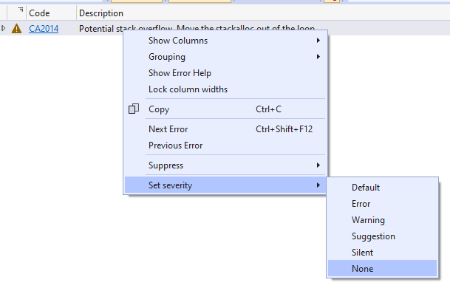
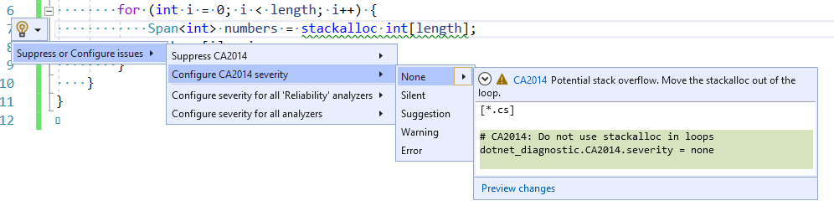
Use Lightbulb or Error List To Modify Editorconfig Settings

Slide 24
Break

Slide 26
Theme: General Correctness
Immutable support: TollCollectorLib.BillingSystem.Owner
init scope
Await in catch/finally: TollCollectorLib.TollCollector.TollSystem.ChargeTollAsync
Also, When in catch, although take that out
async main (run first): TollAppConsole.Program.Main
Tuples: TollCollectorLib.TollSystem.ConcurrentQueue

Slide 27
Theme: General Correctness - not covered
nameof
private protected
async streams (async foreach)

Slide 28
Theme: Null Correctness
is null and is not null: BillingSystem.OwnerList.TryGetValue
Null reference types: BillingSystem.Account.Owner
Bang operator: TollCollectorConsole.Demo
Null conditional: TollCollectorLib.TollSystem (logger)
Null coalescing: TollCollectorLib.TollSystem.ChargTollAsync(accountlist)
Annotating code: BillingSystem.OwnerList.TryGetOwner
Parameter null checks:

Slide 29
Theme: Pattern matching – C# 9 TollCollectorLib.TollCalculator
Where you can use matching:
What you can use:
is (and is not)
Traditional switch
switch expression
var in switch…case
Literal and enum patterns
Types
null
default and discards
Property patterns
Tuple patterns
Positional patterns
Note that case order now matters

Slide 30
Theme: Pattern matching C# 9 TollCollectorLib.TollCalculator
Where you can use patterns:
What patterns you can use:
is (and is not)
Traditional switch
switch expression
var in switch…case
Type patterns (tuples)
and, or, and not
Relational
Parentheses
“Exhaustive” and “never” analysis
Same as C# 8
Note that case order now matters

Slide 31
Theme: Pattern matching
All methods in: TollCollectorLib.TollCalculator

Slide 32
Break

Slide 34
Theme: New ways to think about code
.NET Interactive
Jupyter notebooks
Visual Studio Code
via API
Top level functions

Slide 35
Theme: Records C# 9 ExternalSystems
Correct POCOs Contain:
Constructors to initialize properties
Value equality definitions (Equals and GetHashCode)
IEquatable implementation
== and != operators
ToString implementation
(Optional) Deconstruct counterparts for the constructor

